Slide 1
Portal Vein Injuries and SMV injuries
Taichiro Tsunoyama

Slide 2
Introduction of Portal vein injury
Wounds of the portal vein, although uncommon(0.1% incidence),represent one of the most highly lethal of all vascular injuries
The reported case fatality rate among patients with such wounds who reach the hospital alive has been 39% to 71% in most series
In 90% of cases, portal vein injuries are caused by penetrating trauma

Slide 3
Anatomy of Portal Vein
The portal vein forms by SMV and the splenic vein behind the neck of the pancreas
IMV joins either the splenic vein or SMV
Located just to the right of the body of the second lumbar vertebra and immediately anterior to the left border of the vena cava
Valveless portal vein passes cephalad, inclining slightly rightward (7.5 to 10.0 cm) to reach the hilum of the liver
Divides extrahepatically into right and left branches.
Portal vein lies immediately anterior to the suprarenal segment of IVC

Slide 4
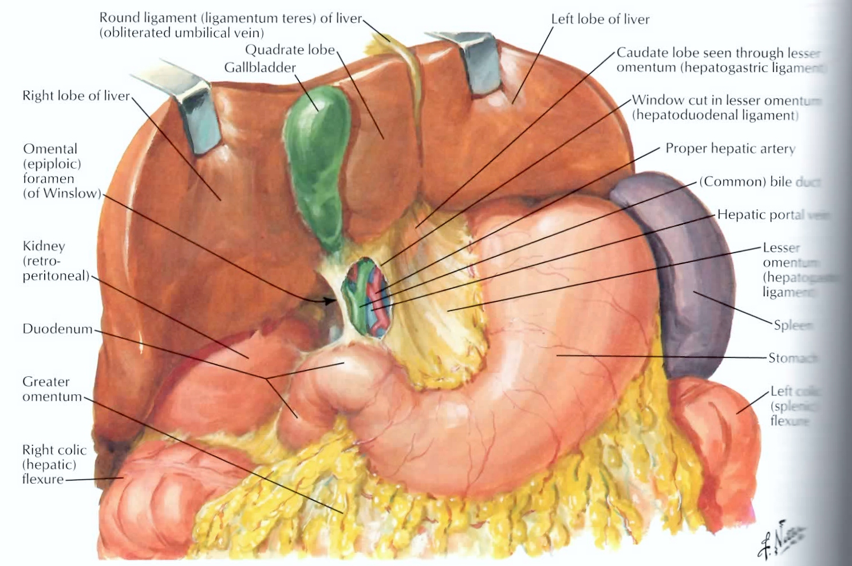

Slide 5
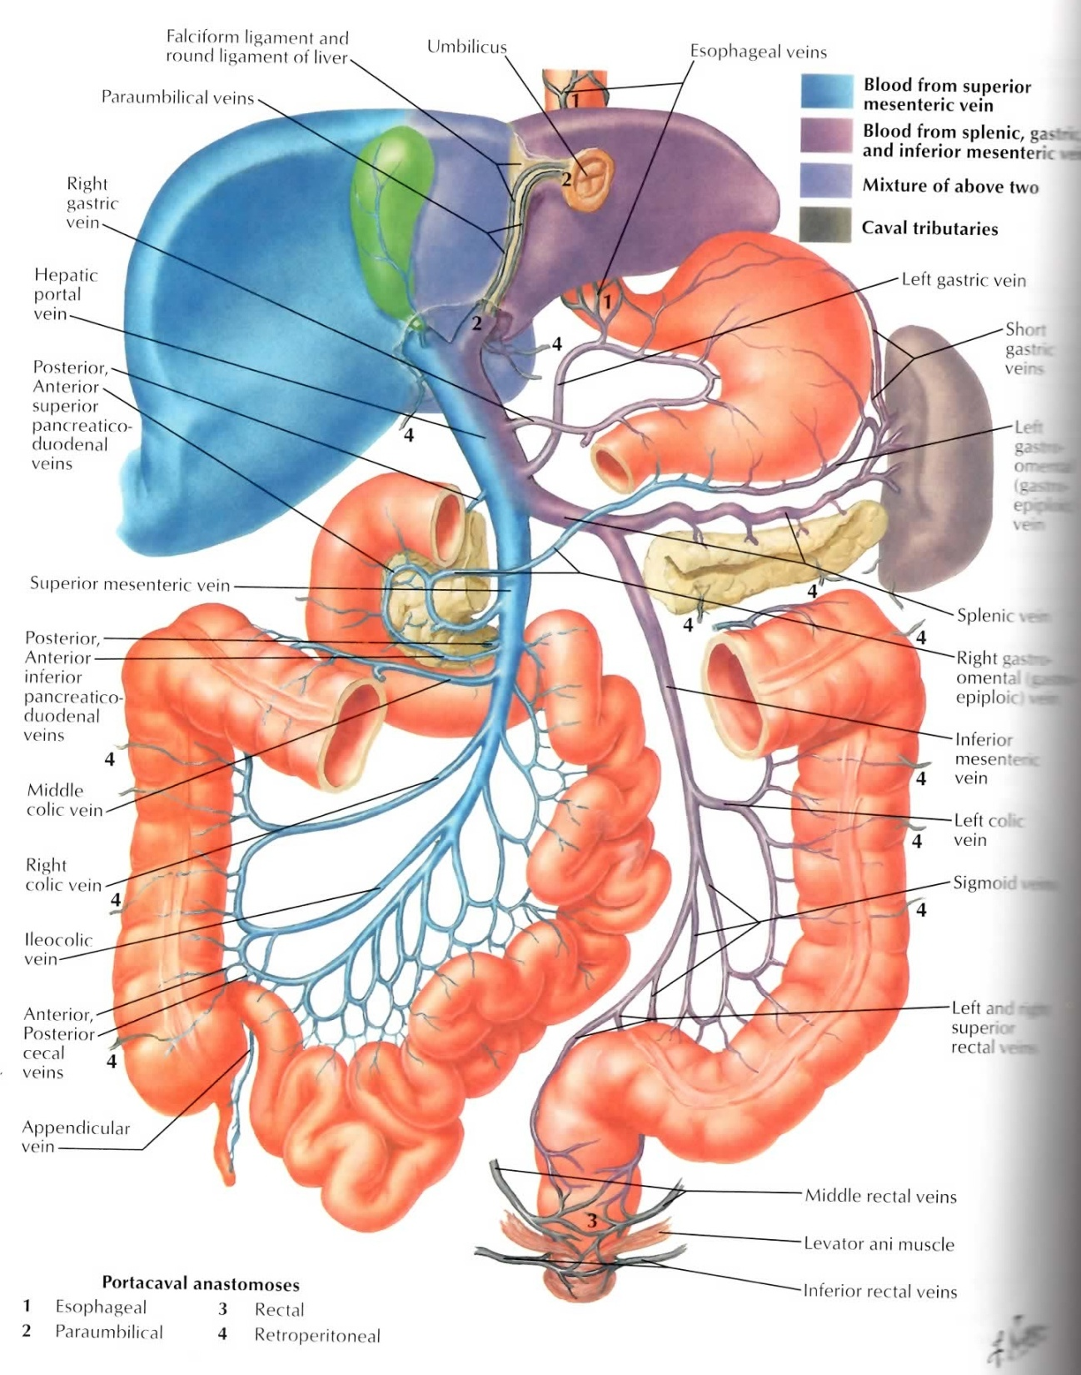

Slide 6
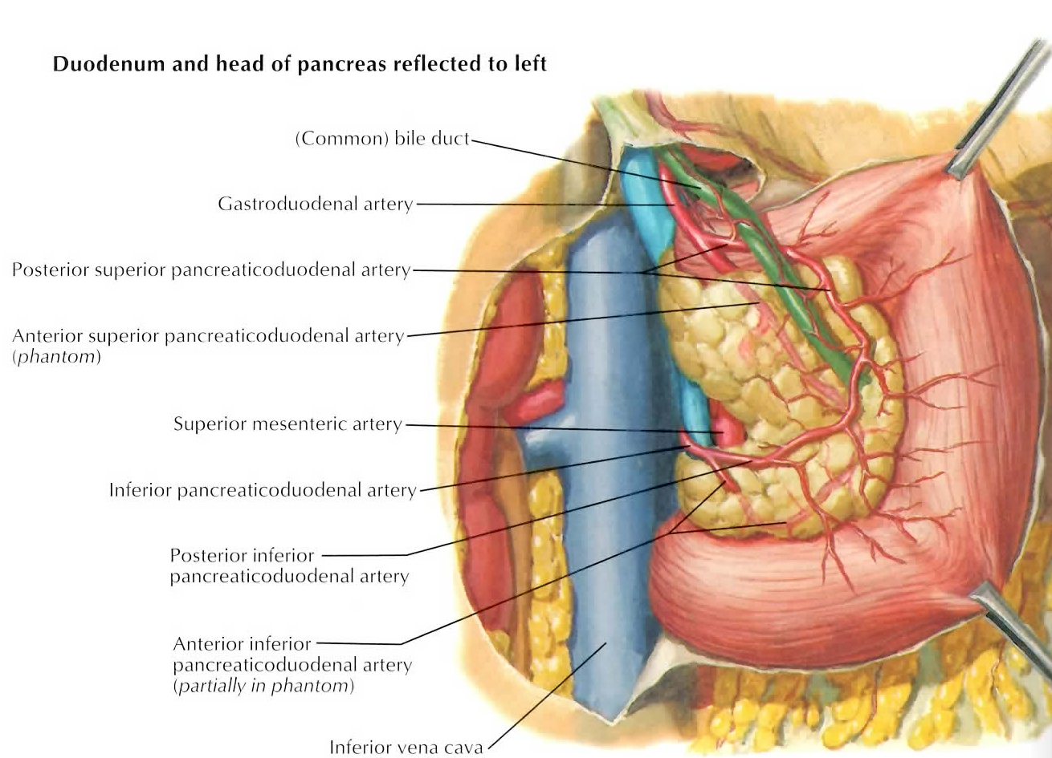

Slide 7
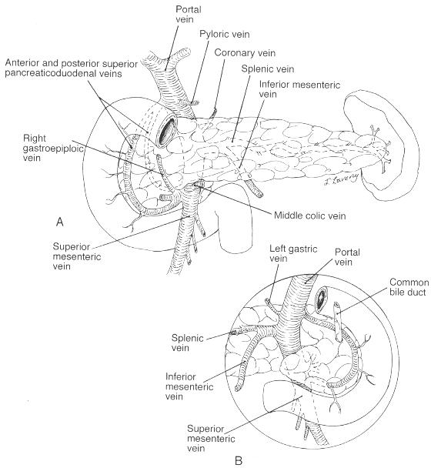

Slide 8
Collaterals in Portal Obstruction
Any retropancreatic injury of the portal vein and its main tributaries could be ligated, with probable preservation
adequate splanchnic drainage
the expectation of collateral antegrade portal flow

Slide 9
Associated Injuries
Almost always are associated with injury to the liver, biliary tract, pancreas, duodenum, or bowel
Major vascular wounds of the IVC, aorta, SMA, or renal vessels, which accompany portal vein wounds in 70% to 90% of cases
Associated major vascular injuries nearly always are posterior to the plane of the portal vein
Produce massive and chaotic, retropancreatic hemorrhage that is extremely difficult to control

Slide 10
INITIAL ASSESSMENT AND MANAGEMENT
Most patients with portal venous injuries present to the hospital in hemorrhagic shock
Approximately half of patients respond to initial fluid resuscitation (some degree of spontaneous tamponade)
The remaining patients have active hemorrhage and require immediate surgery(resuscitative thoracotomy and aortic cross-clamping)

Slide 11
EXPOSURE AND INITIAL VASCULAR CONTROL

Slide 12
Stable Hematoma
Most patients who die from portal vein injuries exsanguinate intraoperatively after the exposure of their vascular wounds
Before opening the hematoma, prepare the equipment
Vascular instruments, balloon occlusion catheters,
stick sponges, tightly rolled laparotomy pads,
blood for transfusion
When a major arterial injury is suspected, preliminary control of the aorta is desirable.

Slide 13
severely shocked patient with active transpancreatic hemorrhage
Manually compress the aorta at its hiatus and then to locate and manually compress the site of bleeding
Some reduction in flow in the portal vein and other vessels in the region
double-clamping the aorta both
superior to the celiac axis
inferior to the renal vessels.

Slide 14
Suprapancreatic Exposure
Wounds of the suprapancreatic portal vein can be exposed by a wide Kocher maneuver, with rotation of the hepatic flexure of the colon as needed.

Slide 15
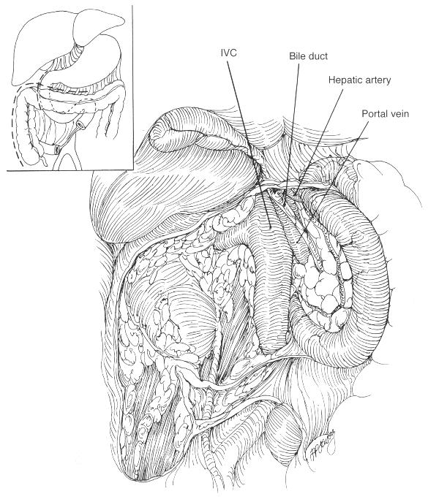
. Exposure of the retropancreatic portal vein and vena cava by a combined medial rotation of the pancreas, duodenum and hepatic flexure.

Slide 16
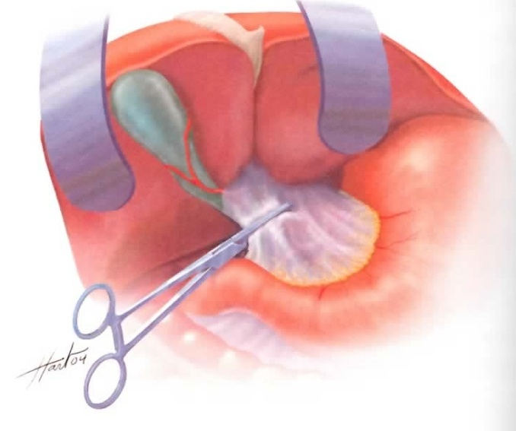
If a major source of hemorrhage is encountered, it must be controlled immediately with a pack
After preliminary hepatic inflow occlusion and the division of the cystic duct, the suprapancreatic portal vein may be dissected to obtain distal control with a vascular clamp or occlusion catheter

Slide 17
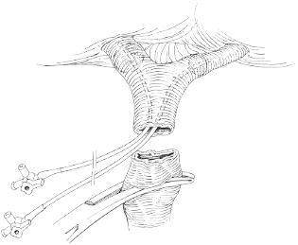
Control of a suprapancreatic portal vein injury using intraluminal catheters for control of the bifurcation and a clamp proximally. A wound of this type may require an interposition vein graft

Slide 18
Retropancreatic Exposure
Combination of
the Kocher maneuver and
mobilization of the entire right colon and mesenteric base,
from the cecum to the duodenojejunal flexure
Provides access to the entire portal vein and the proximal portions of its major tributaries
Also exposes the entire infrahepatic vena cava and the aorta up to the origin of the SMA.

Slide 19
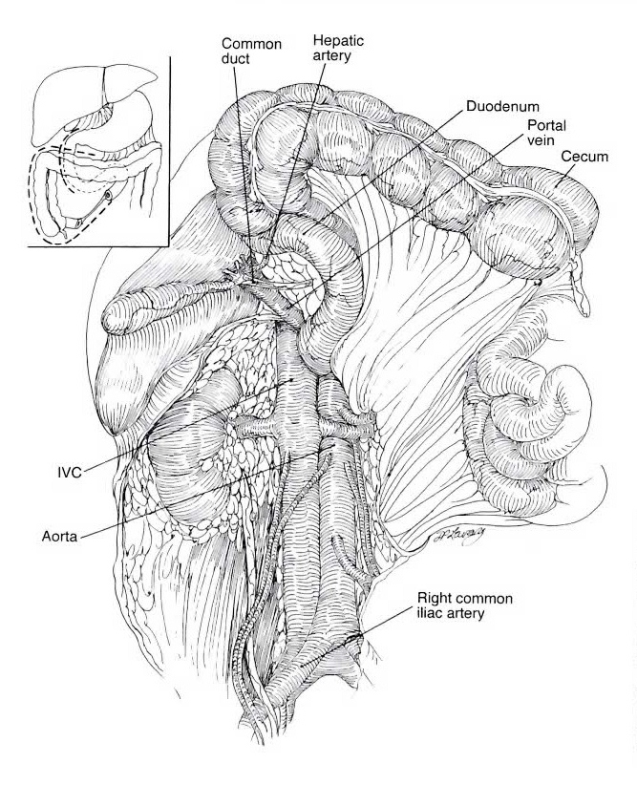

Slide 20
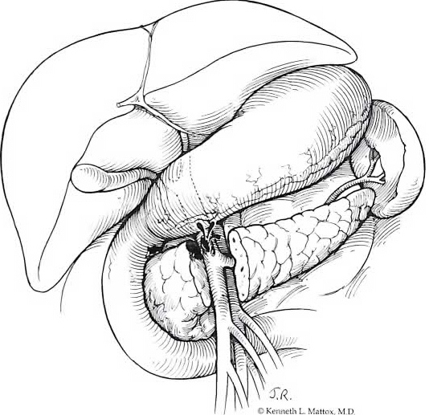
Pancreatic Division
Surgical transection of the neck of the pancreas has been occasionally used as a method of exposing portal injuries
Time consuming and is rarely of value in controlling retropancreatic hemorrhage
Visualization of the anterior aspect of a portal or SMV injury is the only advantage
Performed in pursuit of precise lateral repair of a portal vein or SMV injury

Slide 21
Control of Multiple Vascular Injuries
Once the retroperitoneal hematoma has been entered, must be prepared to immediately control two or more major vascular injuries.
Clamp control of the portal injury is often of secondary concern.
Great vessel lacerations usually must be managed first while the fingers of an compress the portal venous injury, posterior or superior to the mobilized pancreas.
Rotation of the duodenum and pancreatic head provides an opportunity for broad manual compression of the retropancreatic portal vein and its major tributaries

Slide 22
DEFINITIVE REPAIR

Slide 23
Suprapancreatic Wounds
Precise lateral repair, with or without vein patching, or even vein graft interposition, may be used after proximal and distal control
In cases of combined hepatic artery and portal vein wounding, repair of the portal vein, after ligation of the hepatic artery, generally is recommended
Reconstruction of a divided bile duct also may be necessary in this location

Slide 24
Suprapancreatic Wounds
End-to-end anastomosis of the portal vein generally is not feasible
Interposition saphenous vein or PTFE grafting may be a wiser choice for the management of a divided suprapancreatic portal vein
Ligation of the portal vein in this location is compatible with survival provided that the hepatic artery(hepatic inflow vessels) is intact

Slide 25
Retropancreatic Wounds
Fewer and more difficult options for repair
Situation in the retropancreatic zone is far more challenging
Only the posterior aspect of the vein can be visualized by the standard rotation maneuvers
Opportunities for repair are severely limited in wounds of the retropancreatic zone
Visualization of the anterior portion of the vein requires
transection of the pancreas
Difficulties of obtaining proximal and distal control

Slide 26
Retropancreatic Wounds
Oversewn the vein in a way that amounted to complete or near-complete obliteration of the lumen, not only of the portal vein but also of its major tributaries
No major complications have been reported from the use of this approach

Slide 27
Portal Vein Ligation
In hemodynamically unstable patients or in complex PV injury, ligation of the PV is the best choice
In 1950, Child demonstrated that PV ligation was
tolerated in 80% of monkeys
PV ligation results in a rapid fall of systemic arterial
blood pressure and a rise in portal venous pressure with an added risk of bowel infarction
Intestinal infarction and persistent portal hypertension
after PV ligation are rare

Slide 28
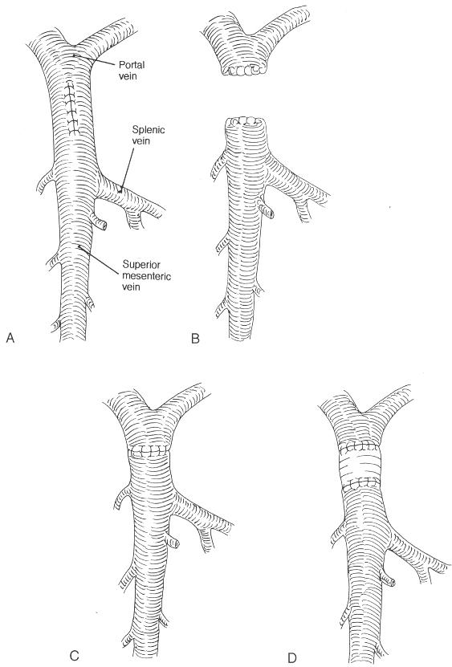
. Four methods of managing portal vein injuries. Of these, only lateral repair (A) and ligation (B) have been commonly used. End-to-end anastomosis (C); graft (D)

Slide 29
Superior mesenteric venous(SMV) injuries
Uncommon but devastating, incurring very high morbidity and mortality
Exsanguinating hemorrhage remains the most common cause of death
Difficult to both expose and establish proximal and distal control
Difficult to repair

Slide 30
SMV injuries are infrequently reported in the literature
In 1954 the first case of an SMV injury was reported in a patient that sustained an associated SMA injury
the SMV was ligated and the SMA was primarily repaired resulting in patient survival
In 1978 Graham reported the largest experience in the literature to date, consisting of 45 injured SMV as part of a series dealing with portal venous injuries
Whether to ligate or primarily repair remains a controversial
Penetrating injury accounts for the majority of SMV
injuries ranging from 80% to 93%

Slide 31
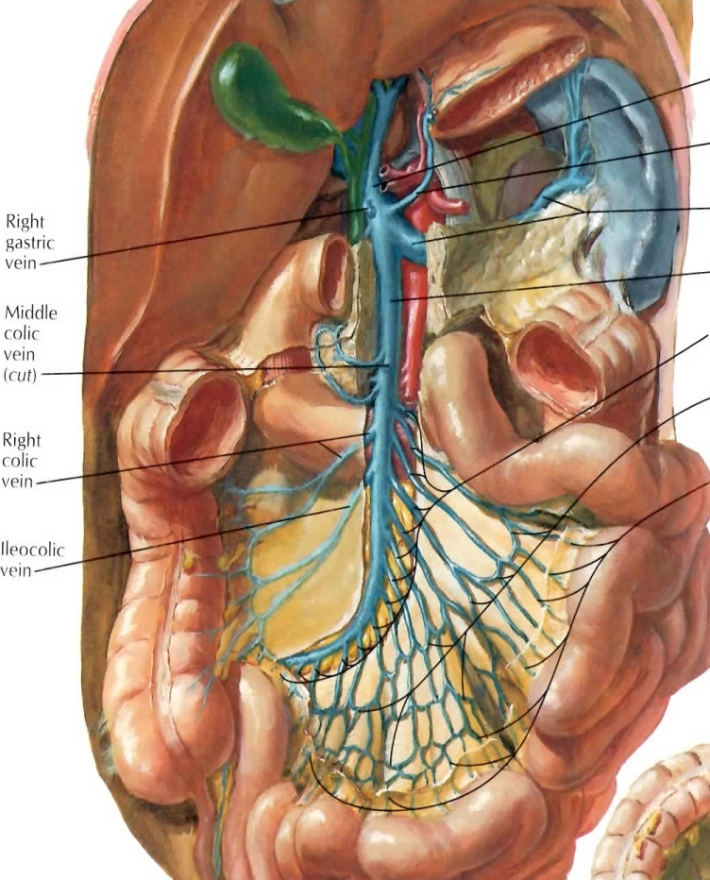
Superior Mesenteric Vein
The iliocolic, right colic, and middle colic veins join the main venous trunk.
Receives the right gastroepiploic vein, the inferior pancreaticoduodenal vein
The proximal portion of the SMV is located in a groove of the pancreas, behind the neck
A part of the SMV is retropancreatic and difficult to expose
most of it is infrapancreatic and easily accessible, and that it has abundant collaterals

Slide 32
Surgical exposure of the SMV
Accomplished by approaching the vessel directly at the root of the mesocolon after reflecting the transverse colon cephalad
Locating the hematoma or active bleeding at the level of the uncinate process of the pancreas
Neck of the pancreas must be elevated utilizing a combination of blunt and sharp dissection maintaining the plane of dissection in the avascular plane

Slide 33
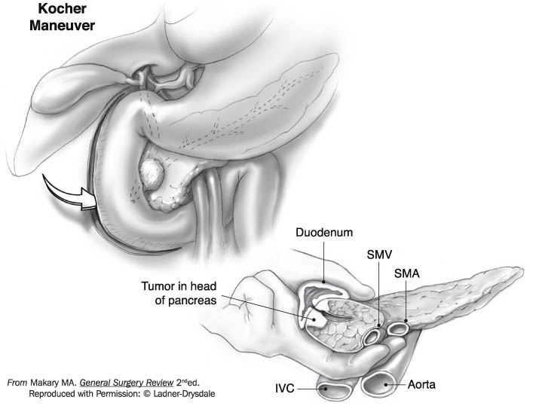
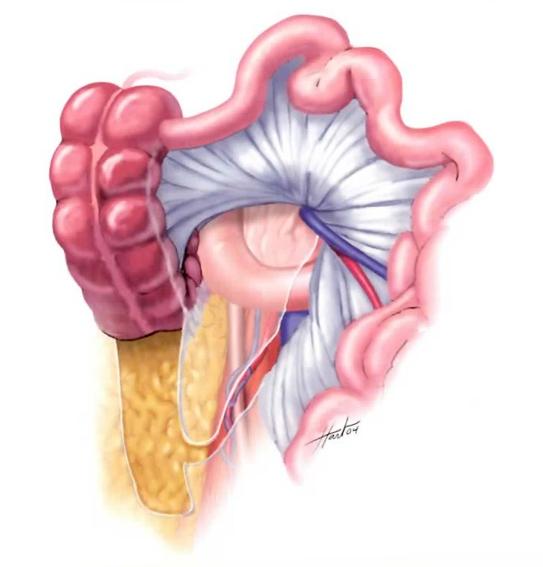
Maneuver for control hemorrhage
Pringle maneuver with digital compression
Right-sided medial visceral rotation including an extensive Kocher maneuver, allows the surgeon to digitally control the superior mesenteric vessels

Slide 34
Actual control of SMV injury
Accomplished digitally with
small vascular partial occlusion clamp
bulldog clamps
Vessel loops
Control of the small venous tributaries, which enter the SMV laterally must be accomplished rapidly with small vascular clips to decrease the amount of hemorrhage

Slide 35
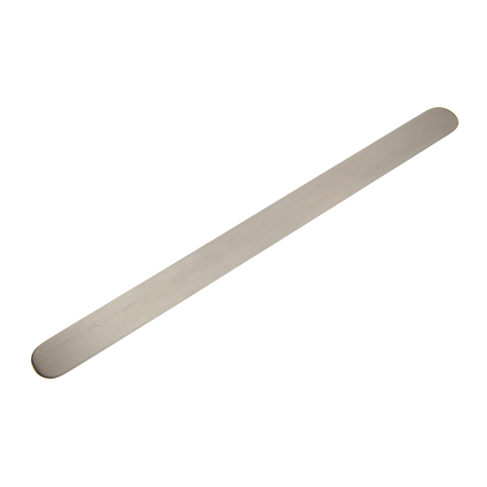
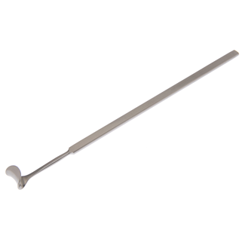
Injuries extend to the confluence of the portal vein, their exposure necessitates elevation of the neck of the pancreas facilitated by
Small malleable ribbon retractor or Cushing vein retractor

Slide 36
Repair of SMV
Primary venorrhaphy
4-0 or 5-0 polypropylene running suture
Thin walled and very fragile vessel that tends to tear easily
Narrowing often results after venorrhaphy
Bypasses with PTFE or reverse saphenous vein grafts (RSVG)

Slide 37
Ligation of SMV
Ligation with nonabsorbable sutures above and below the injury
Significant amount of bowel edema and venous engorgement
Stemic hypotension/splanchnic hypertension syndrome, which may lead to venous thrombosis, bowel ischemia, and necrosis

Slide 38
Primary repair versus Ligation,
Superior mesenteric venous injuries: to ligate or to repair remains the question. Asensio JA J Trauma. 2007 Mar;62(3):668-75

Slide 39
Superior mesenteric venous injuries: to ligate or to repair remains the question. Asensio JA J Trauma. 2007 Mar;62(3):668-75
51 patients Retrospective 156 months study
penetrating 38 (76%)
blunt 13 (24%)
Surgical management
ligation : 30 (59%)
primary repair : 16 (31%)
exsanguinated before repair :5 (10%)

Slide 40
Superior mesenteric venous injuries: to ligate or to repair remains the question. Asensio JA J Trauma. 2007 Mar;62(3):668-75
Overall survival rate was 24/50 (47%)
Primary repair
higher survival rates (63%)
lesser numbers of associated vascular/nonvascular injuries
Ligation
smaller survival rate (40%)
higher number of associated vascular/nonvascular injuries
Ligation appears to be safe and should be selected for hemodynamically unstable patients with a large number of associated injuries

Slide 41
References
PORTAL VEIN INJURIES. Buckman RF Surgical Clinics of North America - Volume 81, Issue 6 (December2001)
Superior mesenteric venous injuries: to ligate or to repair remains the question. Asensio JA J Trauma. 2007 Mar;62(3):668-75

