Slide 1
Geriatric Trauma
For Pre-hospital Trauma Teams
The American Association for the Surgery of Trauma
Geriatric Trauma Committee

Slide 2
Objectives
List major physical and physiologic changes of aging
Describe common patterns of EMS calls for geriatric trauma victims
Outline an ideal approach to caring for geriatric trauma victims

Slide 3


WHY ARE THEY DIFFERENT?
Elderly Patients Have:
Decreased Reserve
Pre-existing Conditions

Slide 4
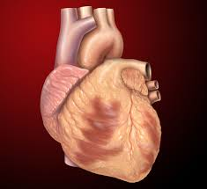
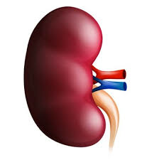
PHYSIOLOGY OF AGING
Cardiovascular
Heart is Less Compliant
↓ cardiac output
↓ Maximum Heart Rate
Autoregulation is Compromised
Renal
Loss of Nephrons
↓ creatinine clearance (but Cr same)
↓ resorptive capacity → Large Volumes of dilute urine, even when dehydrated!

Slide 5
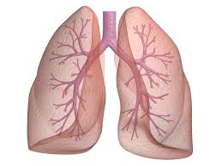


PHYSIOLOGY OF AGING
Pulmonary
↓ Lung elasticity
↓ Chest wall compliance
Endocrine
↓ Production of and responsiveness to thyroid hormone
Metabolism
Can’t mount stress response
But: Protein Catabolism is Not Reduced
Frankenfield, J Trauma 2000; 48:49

Slide 6
PRE-EXISTING CONDITIONS (PECs) AND MORTALITY IN ELDERLY PATIENTS
Liver Disease OR 5.11
Renal Failure OR 3.12
Cancer OR 1.84
CHF OR 1.74
Steroids OR 1.59
COPD OR 1.49
Grossman, J Trauma 2002; 52:242

Slide 7
Population Demographics
Increase in the Number of Persons
Aged 65+ Years in the United States
72
(20%)
Number (millions)
Percent of population
55
(17%)
Population
40
(13%)
35
(12%)
31
(13%)
26
(11%)
20
(10%)
17
(9%)
12
(8%)
5
(5%)
7
(5%)
9
(7%)
3
(4%)
4
(4%)
Year
Notes:
Population estimates place individuals over the age of 65 @ nearly 20% of the entire population by 2020 – when many of you are entering practice.

Slide 8
47% of
seriously injured
young patients are taken to TC’s.
Lane P et al. Geriatric trauma patients-are they receiving trauma center care? Acad Emerg Med. 2003 Mar;10(3):244-50.
Notes:
Geriatric trauma victims are AT LEAST as likely to need trauma center care if not more. But are taken to trauma centers LESS frequently.
107,358 patients were admitted to hospitals in the state because of injury; 8,980 had an ISS > 15; 5,855 were Y and 3,125 were E. Forty-seven percent of the Y patients received TC care compared with only 36.6% of the E patients (p < 0.001). Logistic regression analysis showed that age was a strongly negative predictor for TC care when injury severity was controlled.

Slide 9
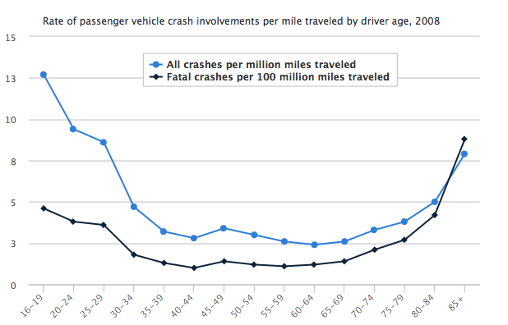

Slide 10

Ohio Geriatric Trauma Field Destination Criteria
Trauma center evaluation indicated if any:
GCS < 14 w/known or suspected TBI
SBP < 100 mmHg
Fall from any height w/known or suspected TBI
Multiple body system injuries
Struck by vehicle
Any proximal long bone fracture after MVC
Elderly patients with co-morbidities (consider)
Werman HA et al. Development of statewide geriatric patients trauma triage criteria. Prehosp Disaster Med 2011;26(3):170-9.

Slide 11


Do the ‘Ohio Criteria’ Work?
≥ 70 years
Outcomes: Need for trauma center care (ISS>15), OR within 48 hours, any ICU stay, in-hospital mortality
101,577 patients; 33,379 (33%) were geriatric
Geriatric criteria:
  More sensitive for need for trauma center care (93% vs 61%)
  Decreased specificity from 61% to 49%
CONCLUSION:
Standard adult EMS triage guidelines provide poorly sensitive in older adults
Ohio Criteria improve sensitivity
Ichwan B et al. Geriatric-specific triage criteria are more sensitive than standard adult criteria in identifying need for trauma center care in injured older adults. Ann Emerg Med. 2015 Jan;65(1):92-100.e3.
Notes:
Though there is some loss of specificity (over-triage), the Ohio field destination criteria increase sensitivity in this vulnerable population.

Slide 12


Is Age Just a Number?
Chronological age- the actual number
Physiological age- the functional capacity of the patients’ organ systems
Notes:
Finally, much of the literature concerning geriatric trauma is relatively “old”, that is, published more than 10 years ago. Given the significant improvements in patient care which have occurred over the past 10 to 20 years, recommendations based upon outcomes achieved more than 10 years ago may not be applicable to today’s geriatric trauma patient.

Slide 13
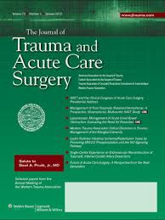

EAST Guideline: Should AGE be a factor?
Trauma Center Evaluation
Aged ≥65 plus preexisting medical conditions should lower the threshold for field triage directly to a designated/verified trauma center.
Severe anatomic injuries (e.g., one or more body systems with an Abbreviated Injury Scale [AIS] score of ≥3) should be treated in designated trauma centers, preferably in ICUs with surgeon-intensivists.
Trauma Activation
A lower threshold for trauma activation if ≥ 65
Calland et al. Journal of Trauma and Acute Care Surgery 2012.

Slide 14
EAST Guideline: Should AGE be a factor?
Overall Decision Making
Advanced patient age is not an absolute predictor of poor outcomes following trauma and, therefore, should NOT be used as the sole criterion for denying or limiting care in this patient population.
An initial aggressive approach should be pursued for management of the elderly patient unless in the judgment of an experienced trauma surgeon it seems that the injury burden is severe and the patient appears moribund.
In ≥ 65 with GCS < 8, if no substantial improvement in GCS in 72 hours of injury, consideration should be given to limiting further aggressive therapeutic interventions.

Slide 15
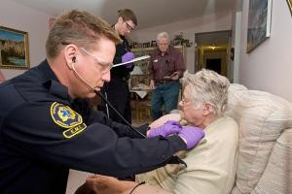
“Lift-Assist Calls”-A Possible Warning Sign
≈5% of EMS calls
2/3 of calls are to 1/3 of the addresses
Recalls within 30 days common:
  10% for falls
  40% for lift
  50% for medical complaints
Conclusion: Lift-assist calls may be warning signs
  Fall prevention?
  Overall medical evaluation?
Cone DC et al. A descriptive study of the "lift-assist" call. Prehosp Emerg Care. 2013 Jan-Mar;17(1):51-6.

Slide 16
Summary
Geriatric population is growing
Organ dysfunction is common
Stress response is less
Destination criteria avoid under-triage
Moderate-severe injuries warrant trauma center evaluation
Don’t assume a poor outcome-give them a chance
‘Lift assist’ calls are opportunities to intervene

