Slide 1
Hypothermia
Taichiro Tsunoyama

Slide 2
Hypothermia is a condition in which core temperature drops below that required for normal metabolism and body functions
Defined as 35.0 °C
Normal body temperature in humans is 36.5–37.5 °C

Slide 3
Body heat is lost to the environment via five mechanisms
radiation
conduction
convection
evaporation
respiration
Notes:
Body heat is lost to the environment via five mechanisms

Slide 4
Radiative heat loss
Secondary to infrared heat emission,
Occurs primarily from the head and noninsulated areas of the body, is the
Most rapid
Accounts for more than 50 percent of heat loss

Slide 5
Conduction
Transfer of heat via direct contact
Thermal conductivity of water is approximately 30 times that of air

Slide 6
Convective heat loss
Movement of fluid or gas
More heat away from the body in windy conditions by rapidly removing the warm

Slide 7
Evaporation and respiration
Evaporation and respiration work via the same mechanism involving water droplets.
Contribute to hypothermia mostly in cool, dry, windy environments, because all liquid will vaporize as the humidity gradient decreases.

Slide 8
To maintain temperature homeostasis
Hypothalamus orchestrates a counterattack against heat loss via heat conservation and heat production
Heat conservation is achieved by peripheral vasoconstriction reducing heat conduction to the skin
Heat production is accomplished by shivering, which can increase the normal basal metabolic rate by two to five times
Nonshivering thermogenesis via increased levels of thyroxine and epinephrine

Slide 9
The causes of hypothermia
Dermal disease
Burns
Exfoliative dermatitis
Severe psoriasis
Drug induced
Ethanol
Phenothiazines
Sedative-hypnotics
Environmental
Immersion
Nonimmersion
Iatrogenic
Aggressive fluid resuscitation
Heat stroke treatment
Metabolic
Hypoadrenalism
Hypopituitarism
Hypothyroidism
Neurologic
Acute spinal cord transection
Head trauma
Stroke
Tumor
Wernicke’s disease
Neuromuscular inefficiency
Age extreme
Impaired shivering
Lack of acclimatization
Sepsis

Slide 10
Clinical thermometers
Special low-reading rectal thermometers or rectal thermistor probes, when available
Tympanic thermometry and bladder probes also have been used frequently in research, but further studies are needed to determine their accuracy in patients with hypothermia

Slide 11
The degree of hypothermia
Mild 32–35 °C (90–95 °F)
Moderate, 28–32 °C (82–90 °F)
Severe, 20–28 °C (68–82 °F)
Profound at less than 20 °C (68 °F)

Slide 12
Symptoms of mild hypothermia 32–35 °C
Smpathetic nervous system excitation (shivering, hypertension, tachycardia, tachypnea, and vasoconstriction).
Cold diuresis, Hypovolemia ,mental confusion, hyperglycemia, as well as hepatic dysfunction may also be present

Slide 13
Symptoms of moderatehypothermia 28–32 °C
Decreased heart rate
Decreased level of consciousness
Decreased respiratory rate
Dilated pupils
Diminished gag reflex
Extinction on shivering
Hyporeflexia
Hypotension

Slide 14
Symptoms of sever hypothermia 20–28 °C
Apnea
Coma
Decreased or no activity on electroencephalography
Nonreactive pupils
Oliguria
Pulmonary edema
Ventricular dysrhythmias/asystole

Slide 15
Laboratory
Renal failure secondary to rhabdomyolysis or acute tubular necrosis
Potassium levels, in particular, fluctuate because of acid-base changes
Coagulopathic because of temperature-dependent enzymes in the coagulation cascade

Slide 16
Management
Removal of wet clothing /replacement with blankets
Aggressive resuscitation with warmed fluid
Trial of glucose
Thiamine
Most dysrhythmias will correct with warming alone
Amiodarone for ventricular fibrillation persists after rewarming
Notes:
most patients have depleted their glycogen stores, and hypothermia masks the clinical signs of hypoglycemia
a patient’s history of alcohol abuse may not be available and thiamine has minimal adverse effects

Slide 17
External rewarming
Heat directly to the skin
Hot water bottles and heating may cause burns
Forced-air warming systems (Bair Hugger )

Slide 18
Active core rewarming
Extracorporeal blood warming(cardiopulmonary bypass, arteriovenous rewarming, venovenous rewarming, or hemodialysis) 1.0 -2.0� °C /3-5minutes
Warm lavage of several body cavities(Gastric, colonic, and bladder lavage,) 1.0� -1.5� ° C/Hour
Peritoneal dialysis 1.0� -3.0 � ° �C /hour
Thoracic lavage 2.2� -3.3� ° C/Hour
Open thoracic lavage involves direct mediastinal irrigation after thoracotomy 8.0° �C /hour

Slide 19
Complication of active external rewarming
Core temperature afterdrop
Results when cold peripheral blood rapidly returns to the heart
minimized by always using minimally invasive core rewarming before active external rewarming
Rewarming acidosis
Rewarming shock

Slide 20
Therapeutic hypothermia

Slide 21
History
The Greek physician Hippocrates advocated the packing of wounded soldiers in snow and ice
During Nepoleon’s invasion of Russia, French surgeons noticed that the soldiers left in snow had a better survival rate that those with a warm blanket.
Induced hypothermia has been studied as a means to protect the brain from ischemia since the 1940s
Most of the early research focused on the applications of deep hypothermia, defined as a body temperature between 20–25 °C

Slide 22
History
In the 1950’s Doctor Rosomoff demonstrated in dogs the positive effects of mild hypothermia after brain ischemia and traumatic brain injury.
Between 1960 and the 1990s, the use of TH
decreased because of its potential for complications.
In 2002, the American Heart Association, followed in
2003 by the European Resuscitation Council, recommended TH as a treatment modality for out-of-the hospital comatose victims of cardiac arrest

Slide 23
Therapeutic hypothermia for Traumatic brain injury
Neuroprotective outcomes in clinical trials that treated head injury using hypothermia are not consistent.
Mild therapeutic hypothermia has been shown to be effective in traumatic brain injury (TBI) with high intracranial pressure (ICP) in adults. No benefit exists for patients with TBI with normal ICP.
Recent meta-analysis of hypothermia clinical trials reported in the third edition of the guidelines for the management of severe TBI in 2007
354 patients: hypothermia groups
340 patients: normothermia groups
This analysis showed that hypothermia treatment was associated with a 46% increased chance of good outcome.

Slide 24
Therapeutic hypothermia for Traumatic brain injury
At present, hypothermic treatment is considered an
experimental therapy and not a standard of care for patients
with severe TBI.
A new hypothermia clinical trial focusing on adult patients younger than 45 with severe TBI was initiated.
This trial emphasizes the use of early cooling and the more consistent monitoring of patient management from the various centers. Recently,this multicenter hypothermia TBI trial was stopped basedon a midstudy analysis indicating no improvement with hypothermia treatment.

Slide 25
BIOLOGICAL AND CHEMICAL REACTIONS TO INJURYIN THE BRAIN
Brain oxygen stores become exhausted within 15 s
Brain energy stores become exhausted within 5 min after global ischemia
Energy loss results in depolarization of cell membranes.
A series of biochemical reactions and cascades initiated by the trauma will then follow.
Those cascade events evolve gradually and may last several days after the initial trauma.
Increase in extracellularK+, energy depletion, disruption of the blood-brain barrier, free radical release, excitotoxicity, and inflammation are

Slide 26
Mechanism of neuroprotection
The slowing of cellular metabolism
For every one degree Celsius drop, cellular metabolism slows by 5-7%
Reduces the harmful effects of ischemia by decreasing the body’s need for oxygen(oxygen free radical )
Encourages cell membrane stability
Reduce reperfusion injury
Reducing excitatory amino acids (glutamate release)

Slide 27
Adverse events associated with hypothermia
Arrhythmia
Decreased clotting threshold(unfavorable effects on platelet function, and prolongs prothrombin and partial thromboplastin)
Increased risk of infection(pneumonia)
Increased risk of electrolyte imbalance(hypokalemia)
Decreases cardiac output by 7% for each 1°C
Gut motility is impaired during hypothermia
Decreases plasma insulin levels

Slide 28
Types of ischemic events
1. Hypothermia therapy for neonatal encephalopathy
2. Cardiac arrest
3. Stroke
4. Traumatic Brain or Spinal Cord Injury
5. Neurogenic Fever

Slide 29
FACTORS AFFECTING THE PROTECTIVE OUTCOMES
1. Time of Cooling Initiation
2. Cooling Extent
3. Cooling Duration
4. Rewarming Rate

Slide 30
Time of Cooling Initiation
1.Experimental data from a rat model demonstrated
the greatest benefits of neuroprotection when hypothermia was induced during global ischemia
2.the apparent window of opportunity for gaining the benefit of
hypothermia extends to only 90 min post trauma

Slide 31
Cooling Extent
1.Many animal studies suggest that the preferred cooling temperature for neuroprotection is between 32 and 35◦C.
2.Many studies have shown improved neurological outcome using mild hypothermia, compared with either the deep cooling group or the normothermia group.

Slide 32
Cooling Duration
1. Secondary effects of brain injury, including edema and elevated pressure, are known to persist several days after focal cerebral ischemia. Therefore, prolonging brain hypothermia therapy
for an equivalent period may benefit those patients.
2. Experimental studies have tested whether a long cooling duration is safe for patients.
Initially, 24 h were proposed, and later, the cooling duration was extended to 48 h.
A recent review documents profound neuroprotective benefits observed in patients with more than 48 h of hypothermia.

Slide 33
Rewarming Rate
1. Rapid rewarming may result in a dangerous rebound of intracranial pressure elevation and cerebral perfusion pressure reduction.
2. Rewarming rate in tissue should be conducted slowly
at 0.5◦C /hour. In some clinical trials, rewarming from hypothermia is conducted with a feedback
control system over 18 h.

Slide 34
Preparation
1. Place an arterial line early for blood pressure monitoring
2. A continuous core temperature monitor should be used
(esophageal, rectal, or bladder temperature )
A secondary temperature device should be used to monitor temperature as well. A bladder probe is only accurate when urine output is adequate.
3. Pulmonary artery temperature probe may be used
4. Patient comfort and sedation
5. Paralysis to prevent shivering

Slide 35
Supportive therapy
1.Mean arterial pressure goal of more than 80 mm Hg is preferred from a cerebral perfusion standpoint
2.Monitor the patient for arrhythmia (bradycardia)
3.Hematologic testing
(hypokalemia in Hypothermia,hyperkalemia in warming)
4.Unexplained increases in serum amylase and lipase levels have been observed during hypothermic therapy
5.Tight glycemic control should be maintained.
6.PCO₂ should be maintained in the reference range (35-45 mm Hg).
7. Do not provide nutrition to the patient during the initiation, maintenance, or rewarming phases of the therapy

Slide 36
Cooling Techniques
Invasive
Cooling catheters
Reduce temperature at rates ranging from 1.5 - 2.0 °C per hour
catheters can bring body temperature to within .1 °C of the target level
Adverse events associated with this invasive technique include bleeding, infection, vascular puncture, and deep vein thrombosis

Slide 37
Cooling Techniques
Non-invasive
Water blankets
Arctic Sun
The Arctic Sun controls the temperature of the water circulating through the ArcticGel Pads via a patient/temperature feedback loop.

Slide 38
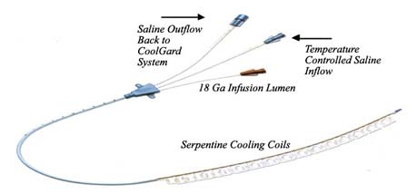
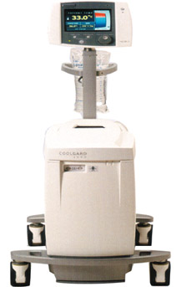
Alsius CoolGard 3000
[ CLOSE WINDOW ]
[ CLOSE WINDOW ]

Slide 39
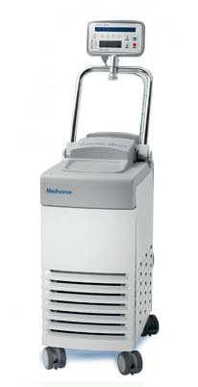
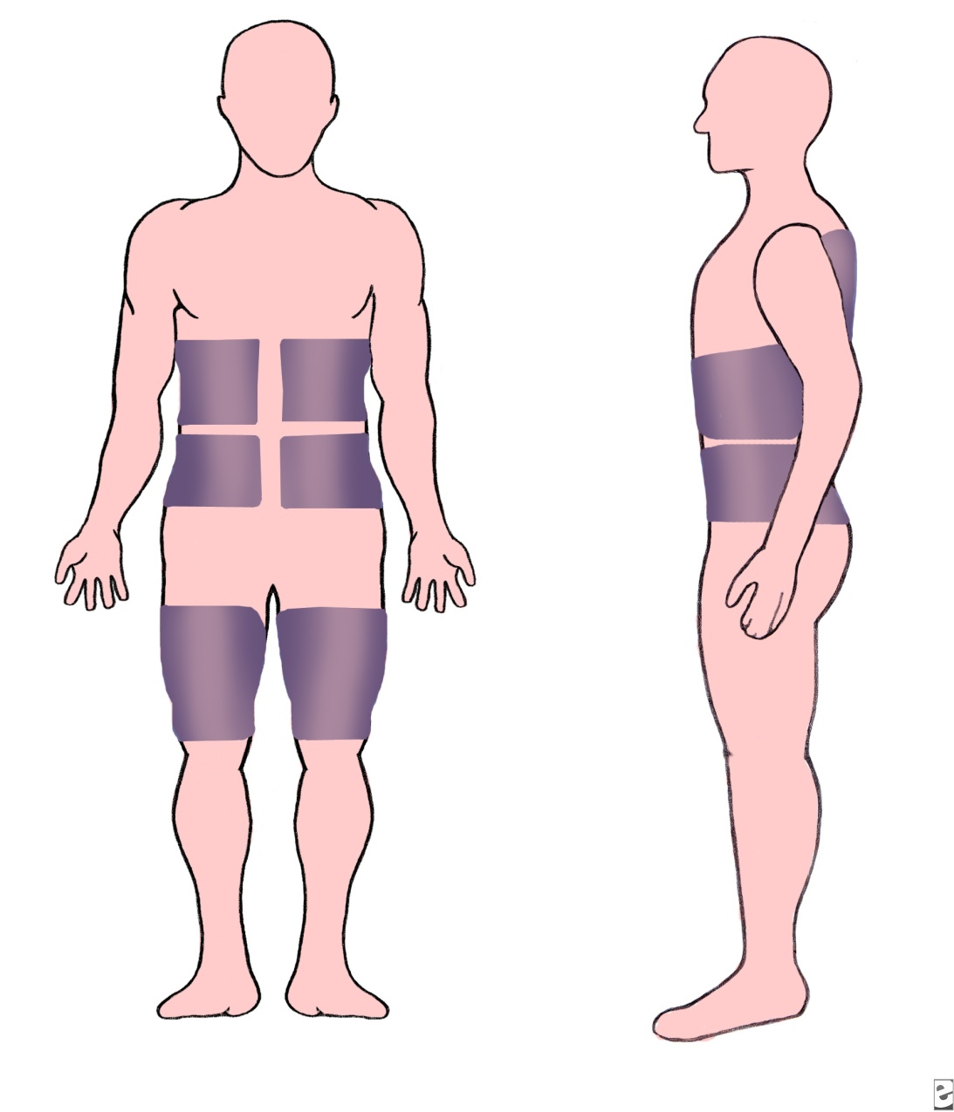
Arctic Sun
[ CLOSE WINDOW ]
[ CLOSE WINDOW ]

