Slide 1
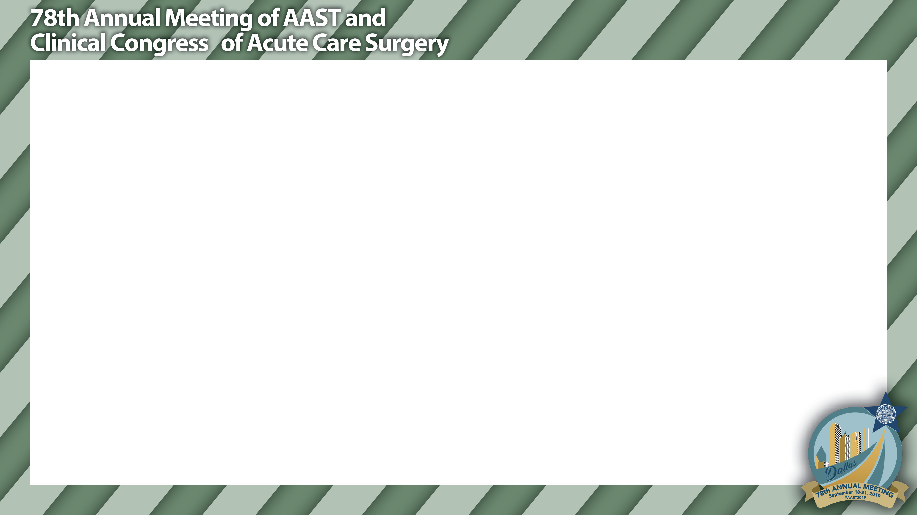
TUBE THORACOSTOMY FOR THE TRAUMA PATIENT;
IT'S NOT JUST ABOUT SIZE
Positive Pressure
(ie. patient on ventilator)
Low Pressure Gradient
(ie. patient who is splinting)
INTRA-THORACIC PRESSURE may be more important than actual tube size
So tube size may not matter after all; unless of course, patient is splinting and has poor respiratory effort.Then a Large chest tube may still be better!

Slide 2
IS THERE A MORTALITY DIFFERENCE IN TRAUMA PATIENTS REPATRIATED TO NON-TRAUMA CENTERS?
PILOT DATA FROM AN EAST MULTI-CENTER TRIAL
YES!
?
Trauma Patient

