Slide 1
Hemothorax
Hassan Bukhari
12/10

Slide 2
Objective
Answer few questions
Can we quantify hemothoraces?
Should we drain all hemothoraces?
Should we administer antibiotic prior to thoracostomy insertion?
Retained hemothorax: VAT vs. 2nd chest tube?
Come up with an algorithm for hemothorax management.

Slide 3
Content
Occult hemothorax
Prophylactic antibiotics prior to thoracostomy insertion.
Retained hemothorax.

Slide 4
Occult hemothorax
Definition
Seen on chest CT but not on supine CXR
Incidence
20-30%
Management
Only 2 retrospective studies addressed this topic

Slide 5
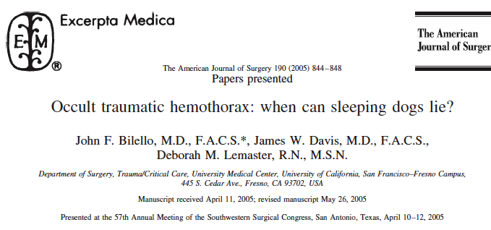

Slide 6
Quantifying hemothorax
CXR, U/S and Chest CT
CT is the most reliable test
Decubitus CXR can be used
Measurements (on CT)
small: < 1.5 cm → 260 ml
Moderate: 1.5-4.5 cm → 260-1000 ml
Large: > 4.5 cm → > 1000 ml

Slide 7
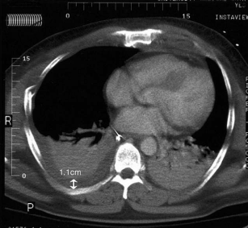
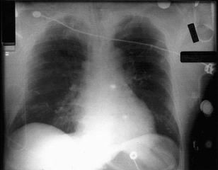

Slide 8
Methods: retrospective

Slide 10
Results
Minimal hemothorax (52 patients)
8 (15%) needed drainage
48 (85%) treated conservatively
44 (92%) succeeded in avoiding drainage
Mod/large hemothorax (47 patients)
31 (66%) needed drainage
28 (34%) treated conservatively
16 (57%) succeeded in avoiding drainage

Slide 11
Conclusion
Hemothorax ≥ 1.5 cm
4 times more likely to undergo drainage.
Recommendation
< 1.5 cm hemothorax can be safely observation

Slide 12
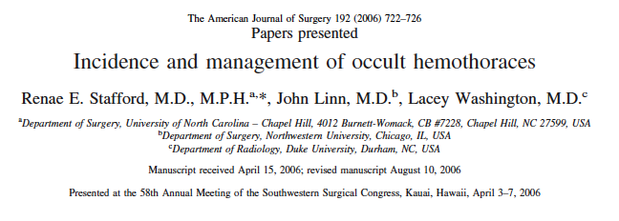

Slide 13
Quantifying hemothorax
CT +/- 3D reconstruction
Occult hemothorax
Not seen on CXR
< 2 cm is considered minimal

Slide 14
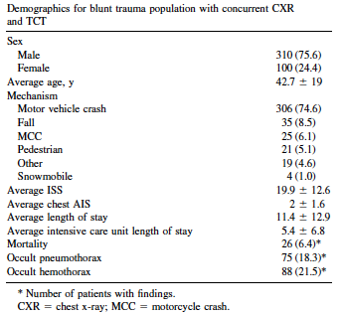
Methods: retrospective

Slide 15
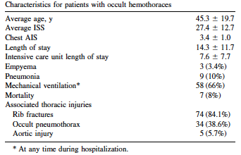

Slide 17
Conclusion
Occult hemothorax
Seen only on CT and size < 2cm can be safely observed.
Occult hemopneumothorax
unknown

Slide 18
Algorithm

Slide 19
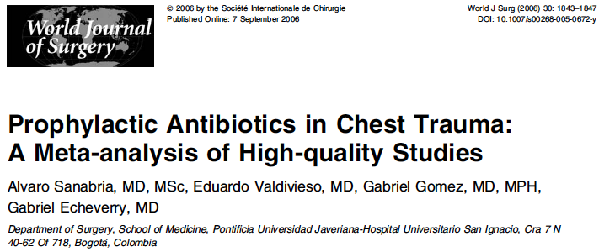
Prophylactic antibiotics

Slide 20
Method: systemic review

Slide 21
Result
Antibiotic given before chest tube insertion and continued for < 24 hrs
Reduces risk of empyema from 7.6% to 1.1%
Reduces risk of pneumonia from 16% to 6.6%
RR of 0.19 (95% CI 0.07-0.5) for development of empyema
RR of 0.44 (95% CI 0.27-0.73) for development of pneumonia

Slide 22
Conclusion
Prophylactic antibiotics prior chest tube insertion for isolated chest injury (blunt or penetrating) has
Protective effective against the development of posttraumatic empyema and pneumonia

Slide 23
Algorithm

Slide 24
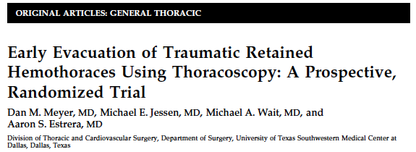
Retained hemothorax

Slide 25
Retained hemothorax
Definition
Persistent hemothorax after chest tube infection, which is diagnosed within 72 hrs.
Incidence
1-20%

Slide 26
Method: prospective randomized trial
Retained hemothorax on CXR after 72 hrs from chest tube insertion
2 groups
Group 1 → second chest tube insertion
If failed → randomized to
VATS vs. thoracotomy
Group 2 → VAT
Duration: 4 years

Slide 27
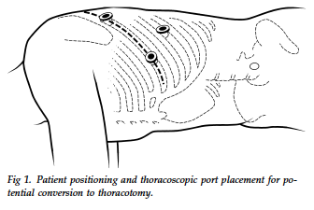
Patient and port position

Slide 28
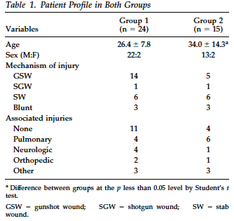

Slide 29
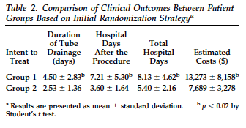

Slide 31
Conclusion
Retained hemothorax
Second chest tube (G1) vs. VATS (G2)
VATS decreases duration of CT, hospital stay and lowered hospital cost.
No mortality
VATS vs. thoracotomy for failed G1
No difference

Slide 32
AAST proposed study
Prospective, observational, multicenter
Management of posttraumatic retained hemothorax.

Slide 33
*Surg Endosc. 2008 Jan;22(1):91-5

