Slide 1
University of Tennessee Health Science Center - Memphis
Surgical Critical Care and Acute Care Surgery Fellowship

Slide 2
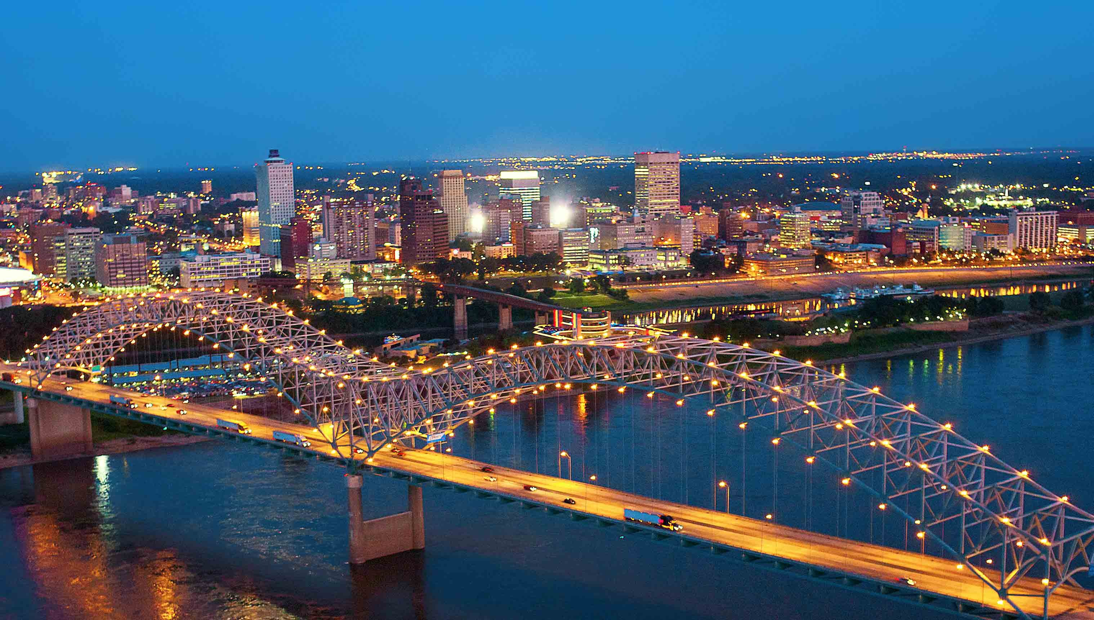
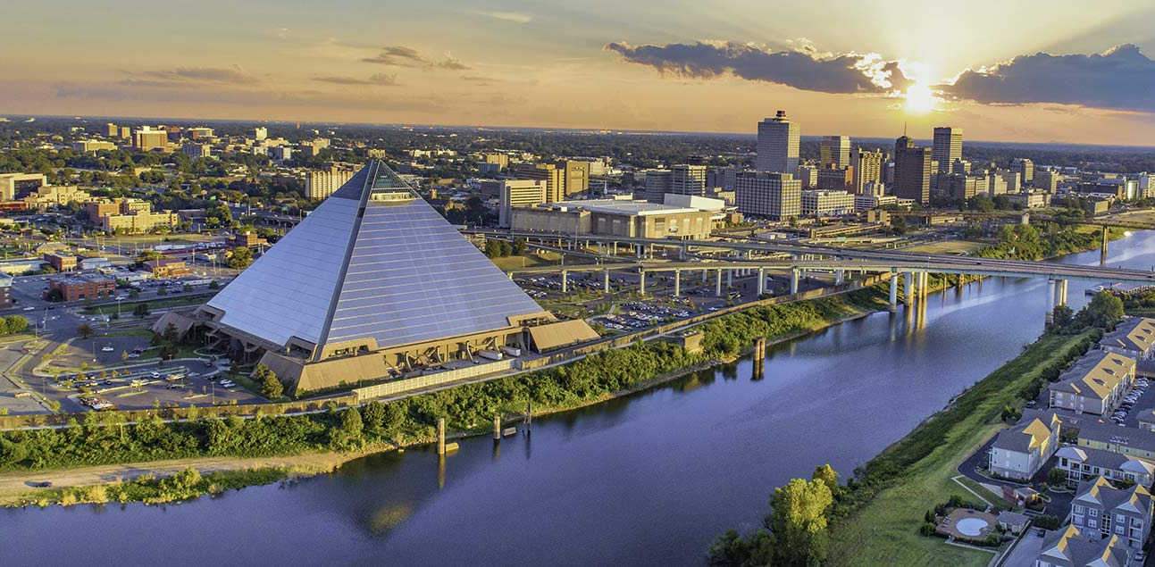
City of Memphis

Slide 3
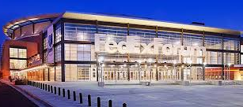
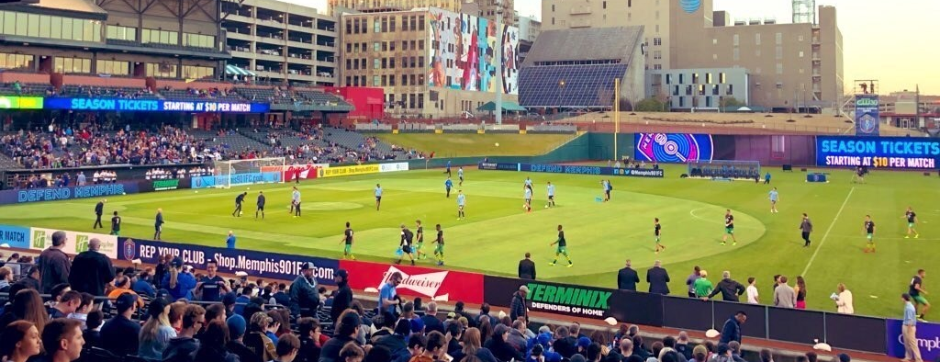

Slide 4
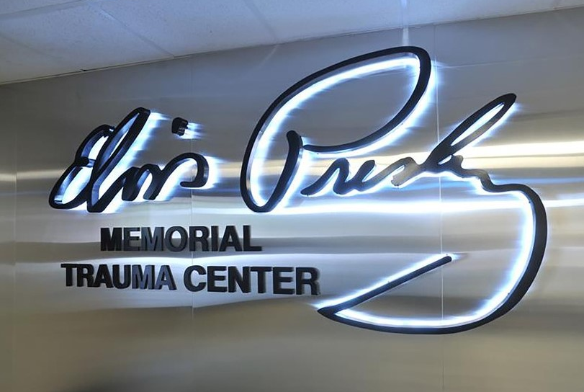
Elvis Presley Trauma Center
Part of Regional One Health
ONLY Level 1 trauma center in 150-mile radius
Evaluate 13,000 traumas per year
Admit 6,000 traumas
30% Penetrating trauma
~ 400 trauma laparotomies per year

Slide 5
Fellowship
1 one-year position
3 AAST two-year positions

Slide 6
First Year Rotations
Trauma ICU
Surgical ICU
Burn ICU
Ultrasound/Airway – 2 weeks
Palliative – 2 weeks
Vascular (for AAST fellows)
Electives

Slide 7
Second Year Rotations
Integrate into attending schedule (obtain instructor appointment at UTHSC)
8 months at ROH
2 service weeks per month
4 overnight calls/ month
Procurement/HPB rotation
EGS
Electives
Book elective cases out of clinic (abdominal wall recons, ostomy take downs)

Slide 8
Electives
Peds trauma
Neuro ICU
Medical ICU
Cardiac ICU - ECMO
Prehospital

Slide 9
Didactics and Conferences
Weekly trauma/SCC didactics
Weekly Fellow EGS/Trauma conference
Weekly trauma M&M– fellows present
Monthly journal club – at Dr. Kerwin’s house
Monthly multidisciplinary peer review
Quarterly multidisciplinary critical care conference (Pulm crit and neurocrit)
AAST Meet the Mentors/Journal Club

Slide 10
Research
Two-year fellows are expected to participate in a quality project or research project
Many clinical opportunities with the faculty
AAST and EAST multicenter trials
Half the faculty have an MPH or MS in Epidemiology

Slide 11
Professional Development
ATLS instructor
ASSET
SCCM Ultrasound Course
AAST Associate Membership
Rib plating courses

Slide 12
Fellow Graduates
UT – Memphis
UT – Knoxville
Prisma Health Columbia, SC
Fairfax INOVA
Alaska Regional
Mt Sinai Chicago
Wash U St. Louis
Temple
Northeast Georgia Health System
Creighton University – St. Joseph’s Hospital, Phoenix
WakeMed

Slide 13
Faculty
Martin Croce – Chief Medical Officer
Andrew Kerwin – Division Chief, Trauma and Surgical Critical Care
Peter Fischer – Trauma Medical Director
Travis Webb – Interim Burn Director
Cory Evans
Dina Filiberto – Program Director, ICU Director
Isaac Howley
Emily Lenart – Trauma Stepdown Director
Saskya Byerly – Associate Trauma Medical Director
Thomas Easterday – Associate Program Director
Sara Soule
Yasmin Ali

Slide 14
Typical Day
7 am – Turnover conference
Didactics lecture (Thursday)
Multidisciplinary rounds (8am – floor, 11am – ICU)
8 – 12 – ICU/Stepdown rounds/Cases
5 pm – Sign out
On call SCC fellow responds the trauma activations (Level 1)
Post call SCC fellow signs out unit to on call fellow

