Slide 1
Shock Kenneth Stahl MD FACS
OBJECTIVES
Define shock and apply to clinical situations
Recognize clinical presentations of shock
Learn the cellular mechanisms and sub-cellular biochemistry of shock
Learn the degrees and grades of shock
Understand diagnostic tests used in patients with shock
Learn treatments for various types of shock

Slide 2
of Types of Shock
5
?
Hypovolemic shock
Cardiogenic shock
Distributive shock → ?
Obstructive shock
Endocrine shock
Septic/neurogenic shock

Slide 3
Stages of Shock
3
?
1. Pre-shock (warm shock or compensated shock): rapid compensation for diminished tissue perfusion by homeostatic mechanisms
2. Shock: compensatory mechanisms become overwhelmed and signs and symptoms of organ dysfunction appear - tachycardia, dyspnea, restlessness, diaphoresis, metabolic acidosis, oliguria, cool clammy skin
3. End-organ dysfunction : irreversible organ damage, no urine output (anuria and acute renal failure), acidemia ,decreases the cardiac output ,coma and patient death

Slide 4
Shock - Clinical Presentation
Anxiety, restlessness, altered mental state (↓cerebral perfusion and subsequent hypoxia)
Hypotension (↓cardiac output, ↓stroke volume)
Pulse (rapid, weak, thready)
Cool, clammy, mottled skin (vasoconstriction, hypoperfusion)
Oliguria (↓renal perfusion)
Hyperventilation (sympathetic nervous system stimulation and acidosis)
Fatigue (late)
Absent pulse in tachyarrhythmia

Slide 5
Shock Cellular Pathophysiology
Inadequate tissue perfusion
Cellular hypoxia
Energy deficit
Lactic acid accumulation (↓pH)
Metabolic acidosis
Cell membrane dysfunction (↓NaK cell membrane pump)
Intracellular lysosome release
Buildup of intracellular toxins
Capillary endothelium damage
Cell dysfunction and apoptosis
Patient death
Anaerobic Metabolism
Vasoconstriction
↓ Pre-capillary sphincters
Peripheral blood pooling
K⁺ Efflux
Na⁺ H₂0 Influx
Cellular swelling
↓Tissue perfusion
↓Urine output

Slide 6
Shock Diagnostic Work Up
There is NO single diagnostic test for shock
Hypotensive trauma patient is in shock
Physical Examination
Patient history (trauma/injury, sepsis, MI)
FST (sometimes)
Swan-Ganz catheter (late, not very useful)
Pro-BNP (Cardiogenic shock)
EKG (arrhythmia)

Slide 7
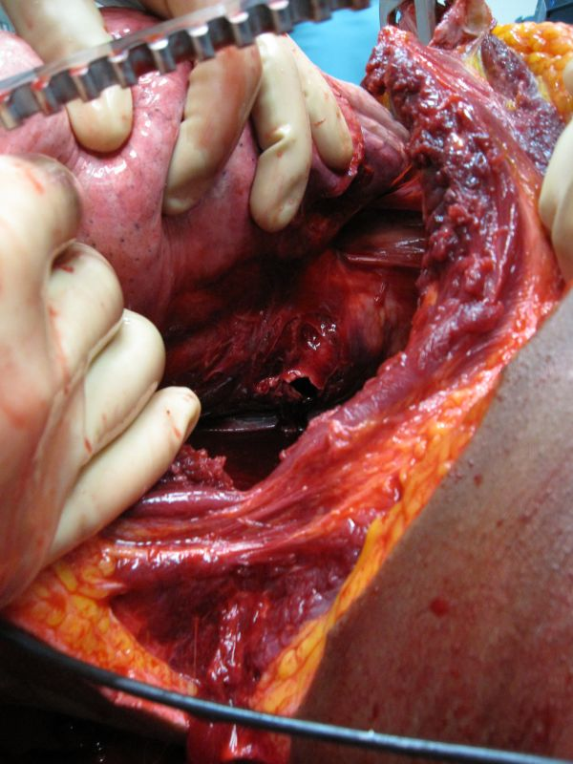
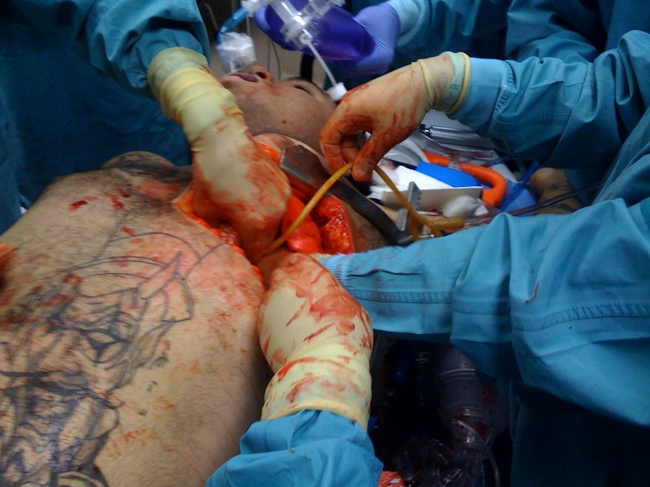
Hemorrhagic Shock Mechanisms
Blood Loss

Slide 8
4 Classes of Shock
 | Class I | Class II | Class III | Class IV
Volume Loss
% Blood volume
∆ Blood Pressure
∆ Heart Rate beats/minute
∆ Pulse Pressure DBP
∆ CNS
∆ Respiratory rate
750 –
1500 cc
1500 -2000 cc
<750 cc
>2000cc
<15%
15-25%
25-40%
>40%
↓↓
↓↓ to absent
↑ to none
↓ to none
100 - 120
120 - 140
<100
>140
↓
↓↓
↓↓ to absent
none to ↑
none to slightly anxious
mildly anxious
anxious to confused
confused to lethargic
normal
20-30
30-40
>40

Slide 9
Class I Hemorrhagic Shock
Loss of <15% of total blood volume (<750cc)
Heart Rate -
Blood Pressure -
Pulse pressure (DBP) -
Respiratory rate -
Delay in capillary refill <3 seconds corresponds to a volume loss of approximately 10%.
CNS – no changes
no change
no change (might ↑ young pts)
no change
no change

Slide 10
Class II Hemorrhagic Shock
Loss of 15-30% of total blood volume (750-1500cc)
Heart Rate -
Systolic Blood Pressure -
Pulse pressure (DBP) -
Respiratory rate -
CNS -
Delay in capillary refill >3 seconds
>100/minute
Mildly decrease
Widened (decreased)
Increased
Anxiety

Slide 11
Class III Hemorrhagic Shock
Loss of 30-40% of total blood volume (1500-2000cc)
Heart Rate -
Blood Pressure -
Pulse pressure (DBP) -
Respiratory rate -
CNS -
Delay in capillary refill >3 seconds
>120/minute
marked decrease
Marked widened & decrease DBP
Increase
marked anxiety

Slide 12
Class IV Hemorrhagic Shock
Loss of >40% of total blood volume (>2000cc)
Heart Rate -
Blood Pressure -
Pulse pressure (DBP) -
Respiratory rate -
CNS -
Delay in capillary refill absent
>140/minute
severe decrease
severe decrease
Increase
Obtunded, comatose

Slide 13
Treatment of Hemorrhagic Shock
1. RECOGNIZE patient is in shock
2. ATLS (ABCDE’s)
3. Volume, volume, volume
4. Surgical – stop bleeding, correct injury
5. Re-establish normal hemodynamics
6. Re-establish urine flow

Slide 14
Obstructive Shock
Cardiac Tamponade
Tension Pneumothorax
Mediastinal Crushing Injury (caval obstruction)
4. Aortic dissection (obstruction)
Mediastinal Torsion
Pulmonary Embolism

Slide 15
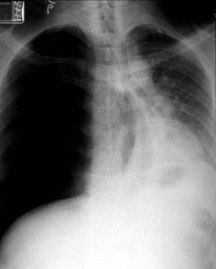
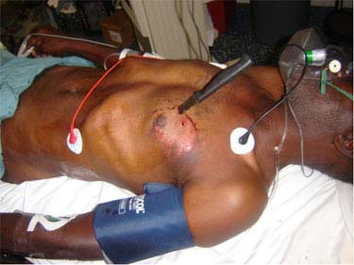
Diagnosis of Obstructive Shock
1. RECOGNIZE patient is in shock
2. Mechanism of Injury
3. Physical examination
4. Chest x-ray, FST, 2-D Echo

Slide 16
Distributive Shock Neurogenic/Septic Shock
Low systemic vascular resistance (SVR)
Spinal chord trauma (neurogenic shock)
Gram negative sepsis

Slide 17
Treatment Distributive Shock Neurogenic/Septic Shock
Control systemic vascular resistance (SVR)
Hemodynamic support
Source control (drain abscess, ∆ CVP lines)
Stabilize spinal chord (neurogenic shock)
Treat gram negative sepsis (broad spectrum antibiotics)

Slide 18
Caridogenic Shock
Valve dysfunction (acute, chronic) AS,AI,MR
Prosthetic valve dysfunction (thrombus, dehiscence)
LV failure (Frank-Starling curves)
Arrhythmia (Ventricular, Atrial)
Aortic dissection (acute AI, tamponade, MI)

Slide 19
Endocrine Shock
Acute adrenal deficiency
Hypothyroidism
Hyperthyroidism (thyrotoxicosis)

Slide 20
Summary
Shock is an circulatory system abnormality that results in inadequate tissue perfusion
Hypovolemia is the cause of shock in the majority of trauma patients
Hypovolemic shock has 4 stages from mild to fatal
There is NO DIAGNOSTIC test for shock
The most important and first treatment for shock is RECOGNIZING patient is in shock

